Slide 1


Chapter 6. From Uniform to Chi-Square
Continuous Probability Distributions

Slide 2
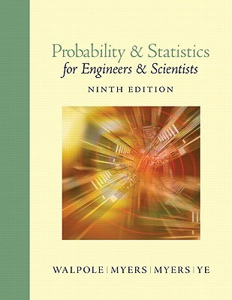
Overview
List:
6.1 Continuous Uniform Distribution
6.2 Normal Distribution (Gaussian)
6.3 Areas Under the Curve. 68-95-99.7 Rule
6.4 Applications of the Normal Distribution
6.5 Normal Approximation to the Binomial
6.6 Gamma & Exponential Distributions
6.7 Chi-Squared (χ²) Distribution

Slide 3

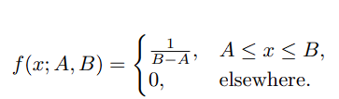

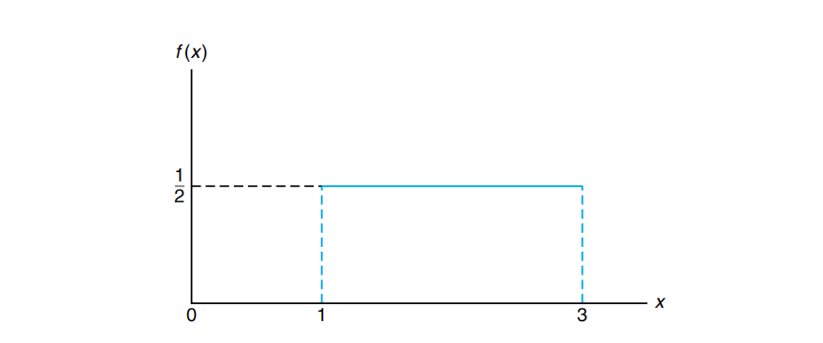
Continuous Uniform Distribution
PDF (Probability Density Function)
Real Life Example
Waiting time for a bus (arrives every 15 minutes).
Random number generators.
Definition:
All outcomes in interval [a, b] are equally likely.

Slide 4
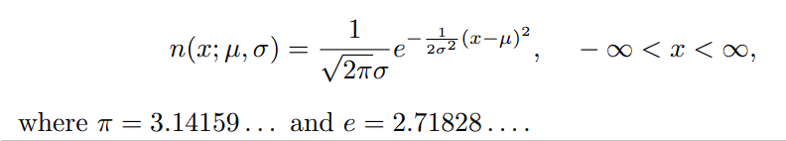
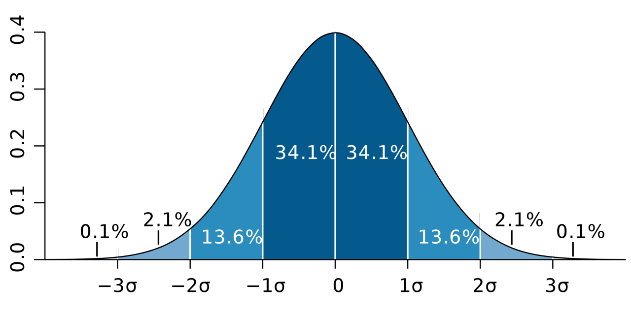
Normal Distribution
(Gaussian)
PDF (Probability Density Function)
Definition:
A continuous distribution with a bell-shaped curve that is symmetric about the mean.
Parameters:
μ (mu) — mean (center of the distribution)
σ (sigma) — standard deviation (spread / width)
Notation: X∼N(μ,σ2)
Key Properties
Symmetric about the mean μ.
Mean = Median = Mode (all equal).
Total area under the curve = 1.
Almost all data (99.7%) lies within μ ± 3σ.

Slide 5
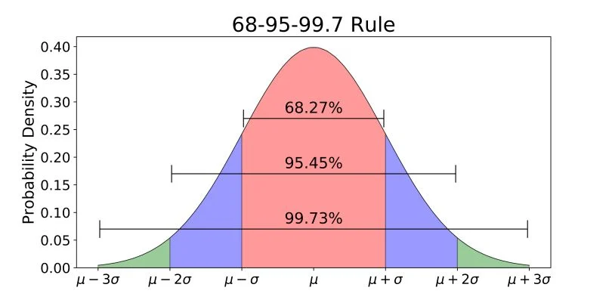
Empirical Rule (68–95–99.7)
The Rule
For any normal distribution:
68% of data falls within μ ± 1σ
95% of data falls within μ ± 2σ
99.7% of data falls within μ ± 3σ
Why It Matters
Quickly estimate spread of data
Identify outliers (values beyond 3σ are rare)
Foundation for statistical process control
Example:
If IQ scores are normally distributed with μ = 100 and σ = 15:
68% of people have IQ between 85 and 115
95% have IQ between 70 and 130
99.7% have IQ between 55 and 145

Slide 6
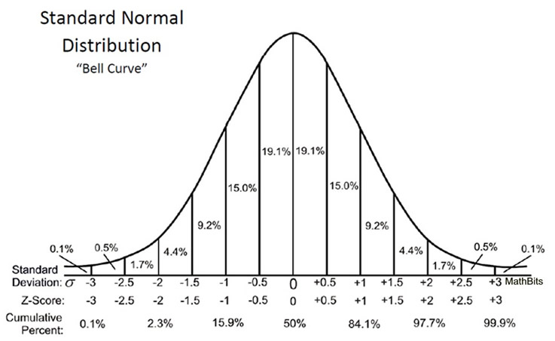


Z-Score (Standardization)
Z-Score Formula
Where:
X = raw score
μ = population mean
σ = population standard deviation
Interpretation
Z-score tells us:
How many standard deviations a value lies from the mean.
Z = 0
Value equals the mean
Z > 0
Value is above the mean
Z < 0
Value is below the mean
Example (IQ scores)
If μ=100,σ=15μ=100,σ=15:
What is the Z-score for IQ = 130?
Interpretation: IQ of 130 is 2 standard deviations above the mean.
→ This corresponds to ≈ 97.5th percentile (only 2.5% of people have higher IQ).
Why Standardize?
Every normal distribution has different μ and σ.
To calculate probabilities, we convert any normal distribution to standard normal:
Z∼N(0,1)

Slide 7
Applications of the Normal Distribution
Education & Testing
📚 Standardized Tests
IQ scores (μ = 100, σ = 15)
SAT, ACT, GRE scores
Grading on a curve
🎓 Student Performance
Comparing students across different classes
Determining grade boundaries
Example: Top 5% of students get an A. Find the cutoff score.
Business & Quality Control
📦 Manufacturing
Package weights (e.g., chips, drinks)
Product dimensions
📊 Risk Management
Stock market returns
Portfolio risk assessment
Example: A machine fills bottles. Amount varies normally around 500ml with σ = 5ml. Most bottles contain 495–505ml.
Science & Medicine
🧬 Biology
Height, weight, blood pressure
Birth weight of newborns
🔬 Measurement Errors
Scientific experiments
Instrument accuracy
🩺 Medical Reference Ranges
"Normal" range for lab tests (95% of healthy population)
Example: Thyroid levels — values beyond 2σ may indicate disease.
Why It's Everywhere
The Normal Distribution appears whenever:
Many small independent factors add up
Measurements vary randomly around a central value
→ It's the foundation of statistics and data science.

Slide 8
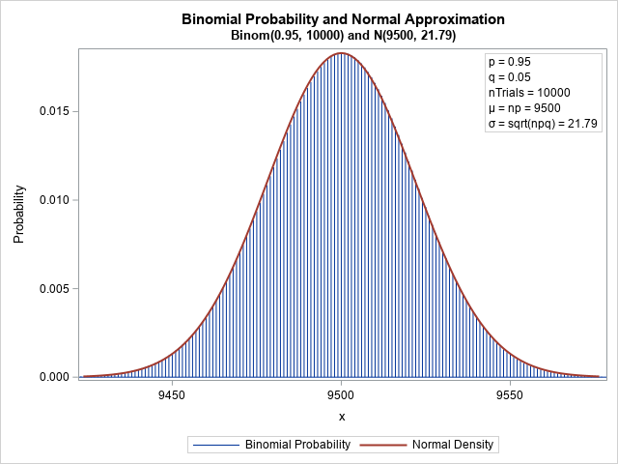
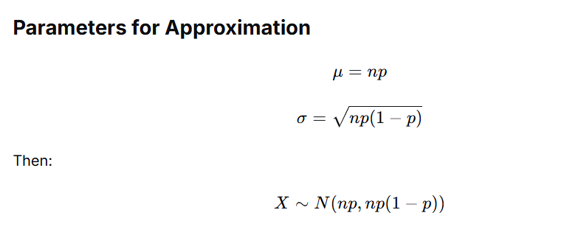

Normal Approximation to the Binomial
The Problem
Binomial distribution:
Models number of successes in n trials
Probability of success = p
When n is large, binomial calculations become difficult.
The Solution
Use Normal Distribution to approximate Binomial when:
np≥5 and n(1−p)≥5
Where:
n = number of trials
p = probability of success
Parameters for Approximation
Example
Coin flipped 100 times
What's P(exactly 60 heads)?
n = 100, p = 0.5
np = 50 ≥ 5 ✓
n(1-p) = 50 ≥ 5 ✓
μ=50,σ=100⋅0.5⋅0.5=25=5
Continuity Correction
Because binomial is discrete (whole numbers) and normal is continuous:
P(X = 60) → P(59.5 < Y < 60.5)
Why It Matters
Makes calculations faster and easier
Used in quality control, surveys, polling
Foundation for statistical inference

Slide 9

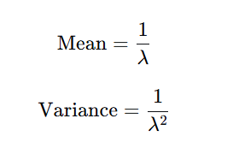

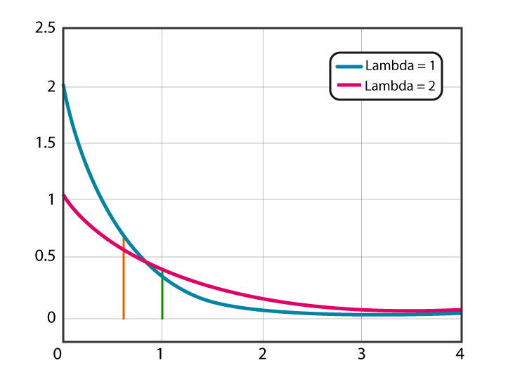
Definition
Models the time between events in a Poisson process.
Examples:
Time until a machine breaks down
Time between customer arrivals
Time until a radioactive particle decays
PDF (Probability Density Function)
Where:
λ = rate parameter (events per unit time)
x = time
Key Properties
Memoryless Property:
Example
A cafe receives customers at a rate of 10 per hour (λ=10λ=10).
What's the probability the next customer arrives in less than 6 minutes (0.1 hour)?
Exponential Distribution

Slide 10
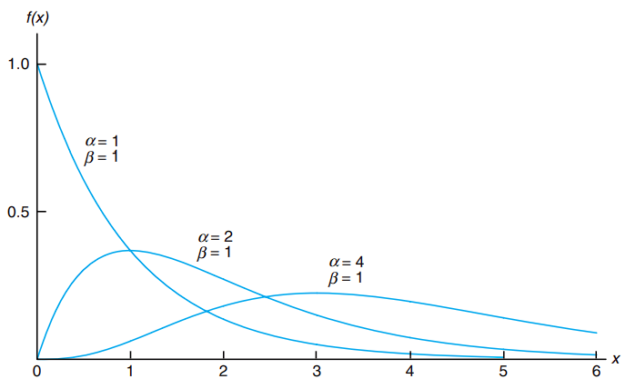

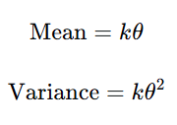
Special Case
When k = 1, Gamma becomes Exponential:
Gamma(1,θ)=Exponential(λ=1/θ)
Gamma Distribution
Definition
Generalization of Exponential distribution.
Exponential waits for the 1st event.
Gamma waits for the k-th event.
Example:
Time until 3rd machine breakdown
Time until 5th customer arrives
PDF (Probability Density Function)
Key Properties
Where:
kk= shape parameter (number of events)
θ = scale parameter
Γ(k) = Gamma function
Example
Machines break down at a rate of 2 per week (θ=0.5).
What's the expected time until 3rd breakdown?
Mean=kθ=3×0.5=1.5 weeks

Slide 11

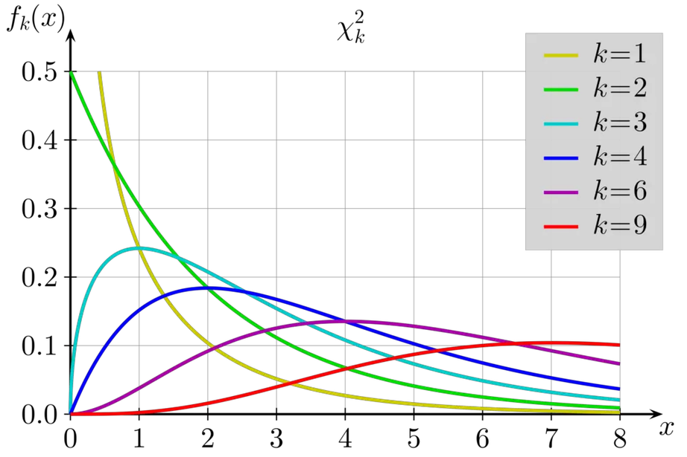
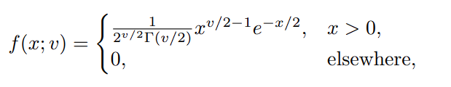
Chi-Square (χ²) Distribution
Definition
Distribution of the sum of squares of independent standard normal variables.
If Z1​,Z2​,...,Zk​ are independent N(0,1):
Where k = degrees of freedom (df)
Why It Matters
Used for:
Goodness-of-fit tests (does data fit a distribution?)
Tests of independence (are two factors related?)
Confidence intervals for variance
Key Properties
Shape: Skewed to the right (positive skew)
Mean = k
Variance = 2k
As k increases, distribution becomes more symmetric
PDF (Probability Density Function)
Example
Research question:
Is there a relationship between gender and preference for a product?
Chi-square test compares observed vs expected frequencies.

